Slide 1









Realtime Messaging Platform

Slide 2





Introduction
Realtime messaging platforms are becoming increasingly popular in today's fast-paced world. They allow for instant communication between individuals or groups, no matter where they are located. This is especially important in industries where time is of the essence, such as healthcare and finance.

Slide 3




What is a Realtime Messaging Platform?
A realtime messaging platform is a type of software that allows users to send and receive messages in real-time. These messages can be text-based, voice-based, or even video-based. The platform works by using a server to facilitate the communication between users. Realtime messaging platforms are often used in team collaboration settings, customer service, and social networking applications. They provide a quick and efficient way to communicate with others, no matter where they are located.

Slide 4
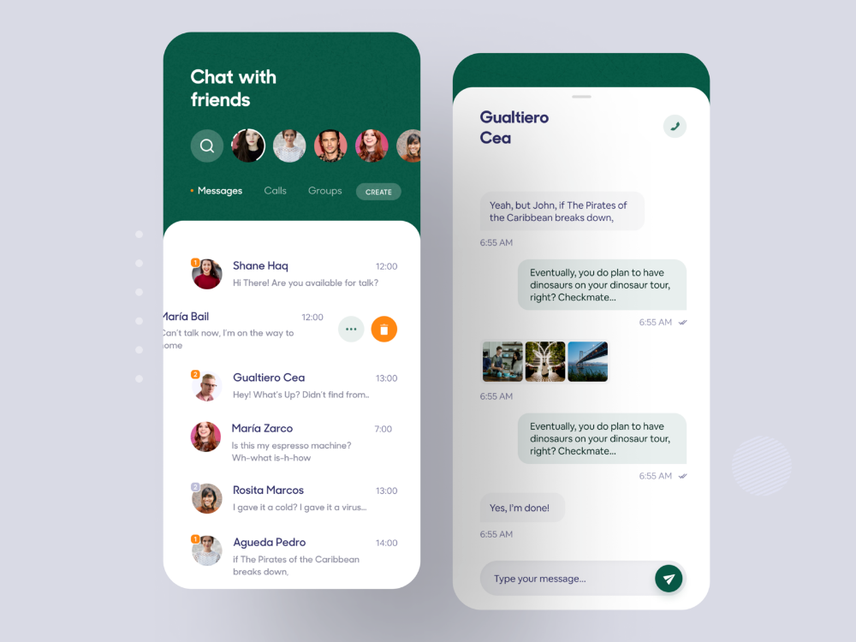


Benefits of Realtime Messaging Platforms
There are many benefits to using a real-time messaging platform. First and foremost, it allows for faster communication between individuals or groups. This can lead to increased productivity and efficiency in the workplace. Realtime messaging platforms also promote collaboration among team members. They allow for easy sharing of ideas and information, which can lead to better decision-making and problem-solving. Additionally, they can improve customer service by providing a quick and convenient way for customers to get in touch with businesses. Overall, Realtime messaging platforms are a valuable tool for any business looking to improve communication and collaboration among team members or with customers.

Slide 5



Features of a Realtime Messaging Platform
There are several key features that are common to most real-time messaging platforms. These include encryption, message history, and user management. Encryption ensures that messages are secure and cannot be intercepted by unauthorized parties. Message history allows users to view past conversations and refer back to them if needed. User management allows administrators to control who has access to the platform and what they can do on it. Some platforms may also offer additional features such as file sharing and screen sharing. When choosing a real-time messaging platform, it is important to consider which features are most important to your business and how they compare across different platforms.

Slide 6




NSQ
real-time messaging platform

Slide 7






NSQ is a realtime messaging platform that enables distributed systems to communicate with each other. It is designed to be scalable, reliable, and flexible, making it an ideal choice for modern applications. With NSQ, you can easily send and receive messages between different components of your application in real-time. This means that you can build complex, distributed systems that are highly responsive and performant.

Slide 8


Benefits of NSQ
1
2
3
One of the key benefits of NSQ is its scalability. Because it uses a decentralized architecture, it can easily handle large volumes of messages without slowing down or becoming overwhelmed. This makes it an ideal choice for high-traffic applications.
Another advantage of NSQ is its reliability. With built-in replication and failover mechanisms, NSQ ensures that messages are always delivered, even in the event of node failures or network outages. This makes it a great choice for mission-critical applications.
Finally, NSQ is highly flexible and can be used in a variety of different use cases. Whether you're building a real-time chat application or a distributed data processing system, NSQ can help you achieve your goals.

Slide 9
NSQ Use Cases
NSQ has been used in a variety of different industries and use cases. For example, it has been used to power real-time chat applications, distributed data processing systems, and high-traffic websites.In the finance industry, NSQ has been used to build high-performance trading systems that require low-latency messaging. In the healthcare industry, it has been used to enable real-time communication between medical devices and electronic health records.Overall, NSQ's flexibility and scalability make it a great choice for any application that requires real-time messaging capabilities.

Slide 10

Distributed Algorithm Used by NSQ
NSQ uses a distributed consensus algorithm called Raft to ensure fault tolerance and data consistency. This algorithm elects a leader node that handles all write requests, while follower nodes replicate the leader's state. If the leader fails, a new leader is elected from the remaining nodes. This ensures that messages are always delivered, even in the event of node failures. In addition to Raft, NSQ also uses a gossip protocol for discovery and communication between nodes. This allows nodes to share information about their state and the state of other nodes in the system, ensuring that messages are always routed through the most up-to-date paths.

Slide 11
How NSQ Works
NSQ works by using a decentralized architecture that allows messages to be sent and received across multiple nodes in a cluster. Each node is responsible for storing and forwarding messages to other nodes as needed.When a message is sent to NSQ, it is first stored in memory on the local node. From there, it is replicated to other nodes in the cluster to ensure high availability. Once the message has been successfully delivered to all subscribers, it is removed from the system.

Slide 12


Realtime Messaging Platforms and Distributed Systems

Slide 13



Realtime messaging platforms rely heavily on distributed systems to function effectively. These systems are designed to handle large volumes of data, ensuring that messages are delivered quickly and reliably. By using a distributed architecture, these platforms can scale up or down as needed, depending on demand. This means that they are able to handle sudden spikes in traffic without compromising performance or reliability. In addition to scalability, distributed systems also offer fault tolerance. If one node fails, the system can automatically route messages through another node, ensuring that messages are still delivered. This is crucial for real-time messaging platforms, where even a small delay can have significant consequences. By using distributed systems, these platforms can ensure that messages are always delivered quickly and reliably, no matter what happens.

Slide 14
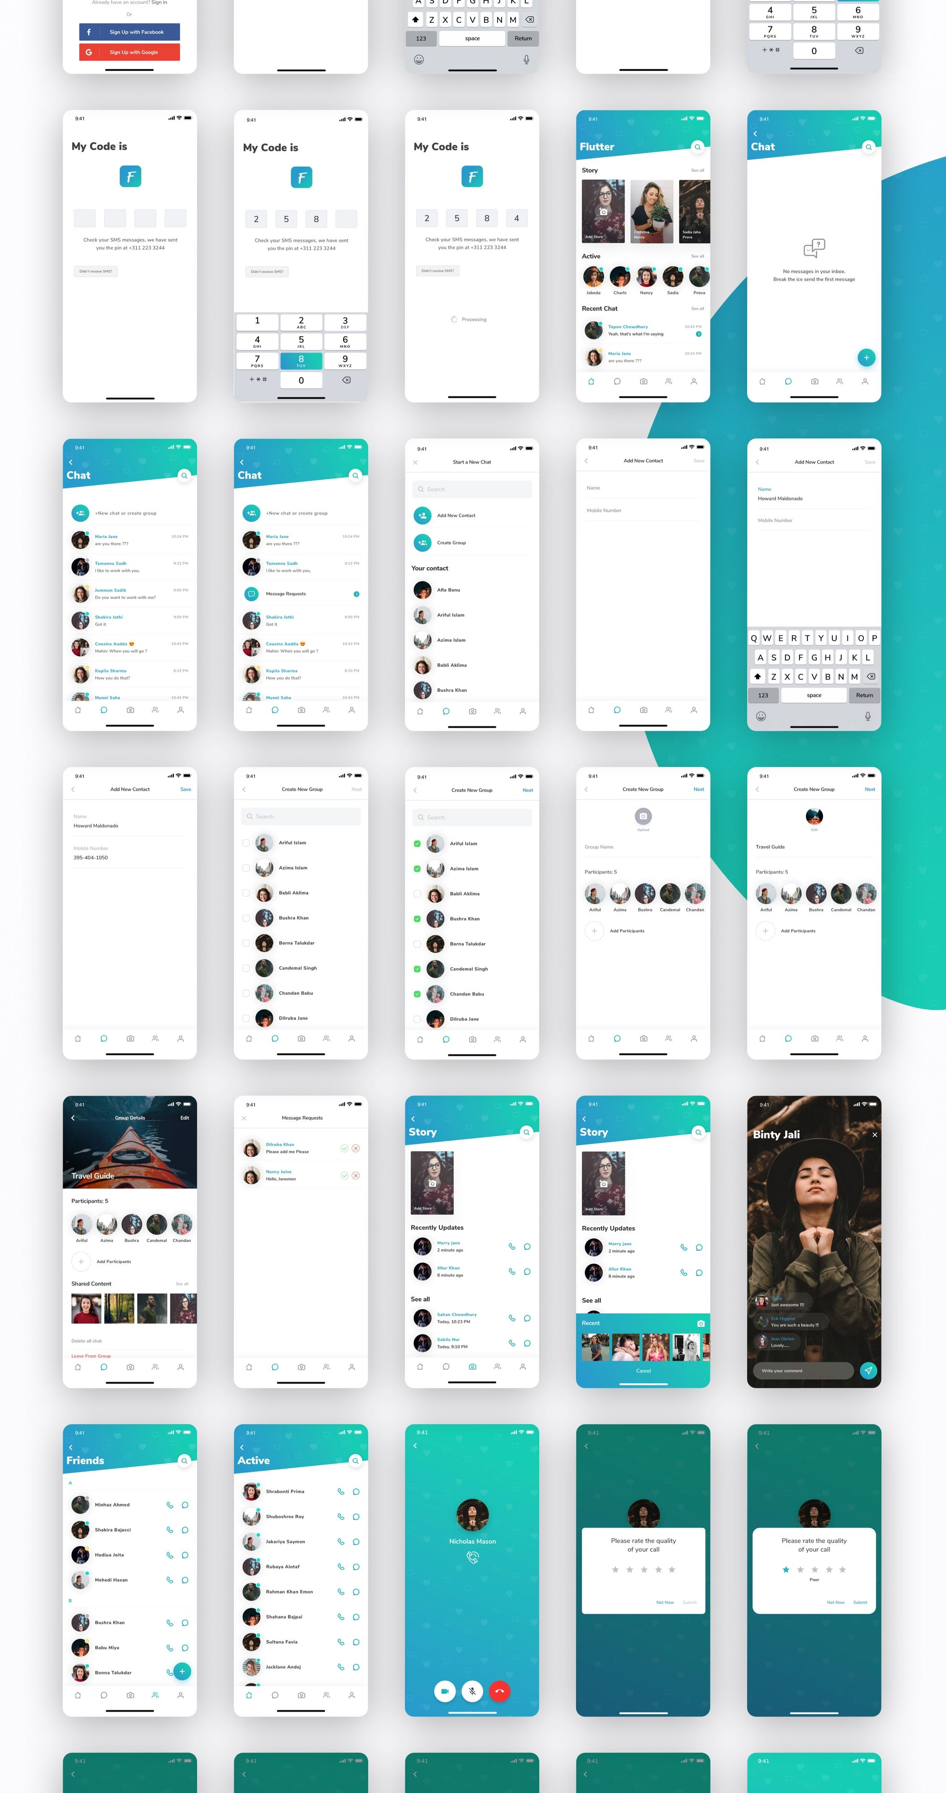



Lamports Algorithm
Lamport timestamps, is commonly used in real-time messaging systems to establish a partial ordering of events and ensure causal consistency. Lamport timestamps are logical timestamps assigned to events in a distributed system, allowing for the detection of causality relationships between events.
In real-time messaging systems, Lamport timestamps are often used to order and coordinate the processing of messages across distributed nodes or brokers. Each message is assigned a Lamport timestamp that represents the ordering of events across the system. The Lamport timestamp reflects the concept of "happened-before" relationship between events, indicating the potential causality between them.

Slide 15
Features of Lamports Algorithm
Logical timestamps assigned to events
Establishes a partial ordering of events based on the happened-before relationship
Events with lower timestamps happened before events with higher timestamps
Enables detection of causality relationships between events
Not based on physical time but rather on the ordering of events
Simple and widely used algorithm in distributed systems
Helps maintain event ordering and coordination across distributed nodes
Provides a means to track causality and dependencies among events
Used to ensure consistency and correct ordering of events in real-time messaging systems
Can be used alongside other algorithms and techniques for fault tolerance, replication, and coordination in distributed systems

Slide 16




Conclusion
realtime messaging platforms are an important tool for businesses looking to improve communication and collaboration among team members or with customers. They offer many benefits, including faster communication, increased productivity, and improved customer service.

Slide 17


THANK YOU

